Slide 1
Algorithmic choice relocates power
BLUESKY RQs + DATA
In data collection phase…
FEB 2026

Slide 2
System framing: pluggable services, new chokepoints
Takeaway: modular services relocate concentration.
viewer
discovery surfaces
feed generators
provider hosting
exposure outcomes
labelers
Discovery surfaces and provider hosting are key chekepoints.
FEB 2026

Slide 3

Bluesky UI: feed marketplace (/feeds)
Takeaway: feeds are discoverable + selectable algorithmic timelines.
A. /feeds directory
C
A
Search feeds
B
B. Feed cards
Creator + likes
C. Trending widget
Defaults matter
Discovery risk
FEB 2026

Slide 4
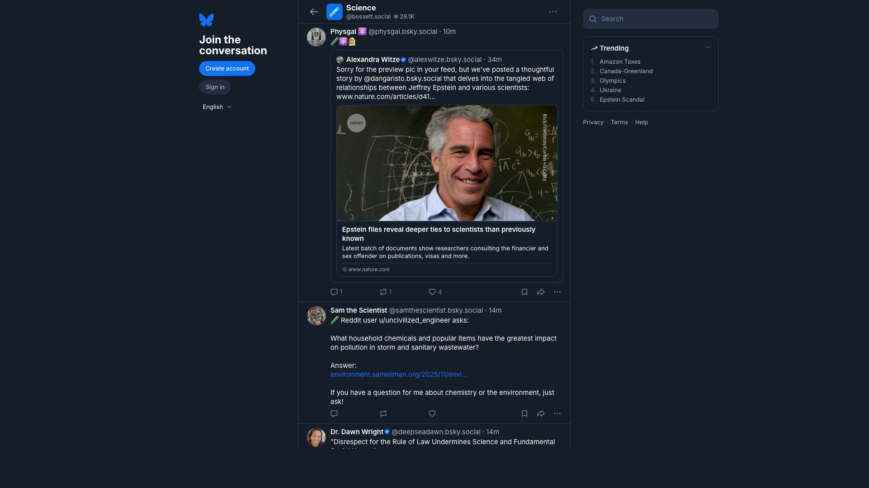
Bluesky UI: what a feed looks like
Takeaway: a feed page renders an algorithm into a timeline of posts.
A. Feed name
A
Demand signals
B
B. Timeline output
Exposure decisions
C. Post actions
C
Why we measure
Manipulation risk
FEB 2026

Slide 5

Bluesky UI: starter packs (onboarding bundles)
Takeaway: starter packs bundle people (and sometimes feeds) for fast onboarding.
A. Pack title
A
Curated list
B
B. Join button
1-click onboarding
C
C. People cards
Curation questions
Measure exposure
FEB 2026

Slide 6
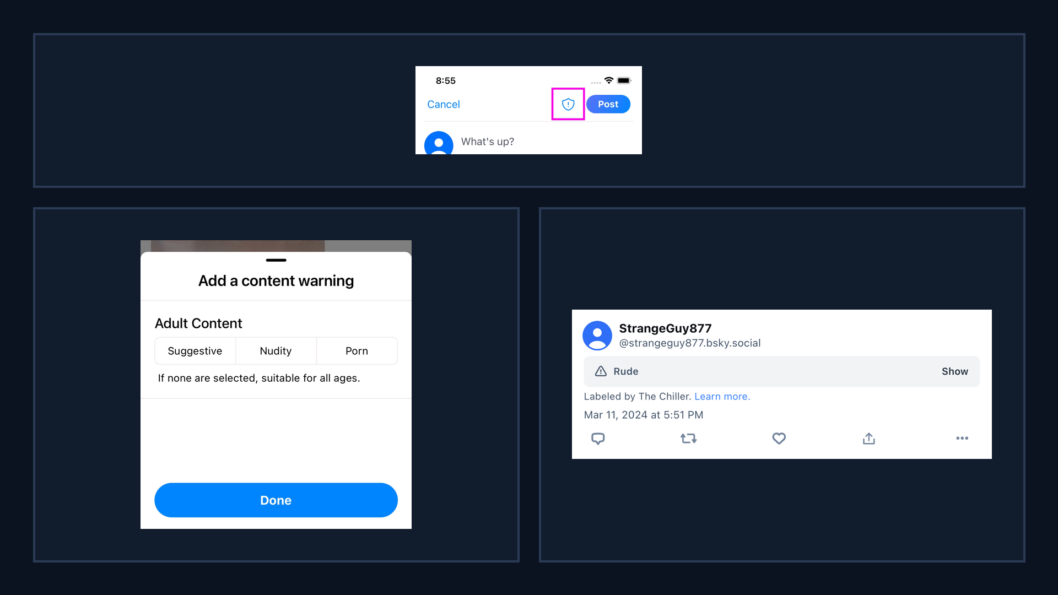
Bluesky UI: labeling surfaces
Takeaway: labels are user-facing controls that shape what gets shown or filtered.
A. Self-label button
A
Composer surface
B. Content warning picker
B
C
Adult Content options
C. Labeled post banner
Attribution to labeler
Why it matters: filtering + exposure

Slide 7
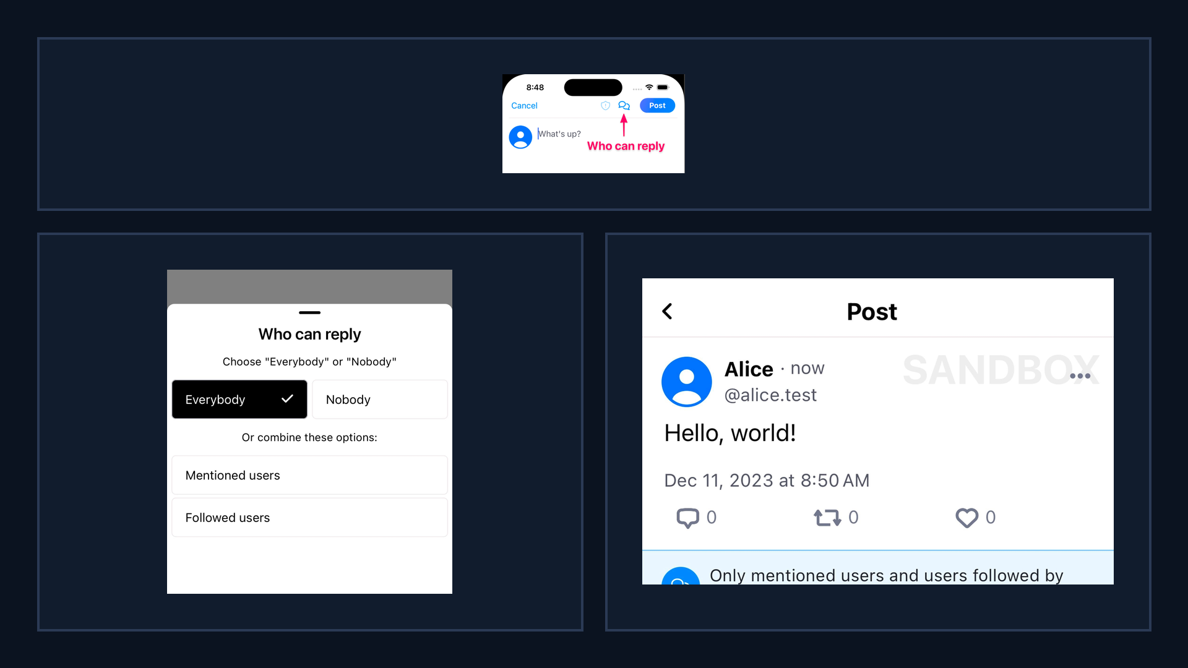
Bluesky UI: reply controls
Takeaway: reply controls gate interaction, changing who can respond and what feedback loops form.
A. Reply controls button
A
Composer setting
B. Who can reply picker
B
C
Audience gating
C. Post notice
Visible constraint
Why it matters: interaction graphs

Slide 8
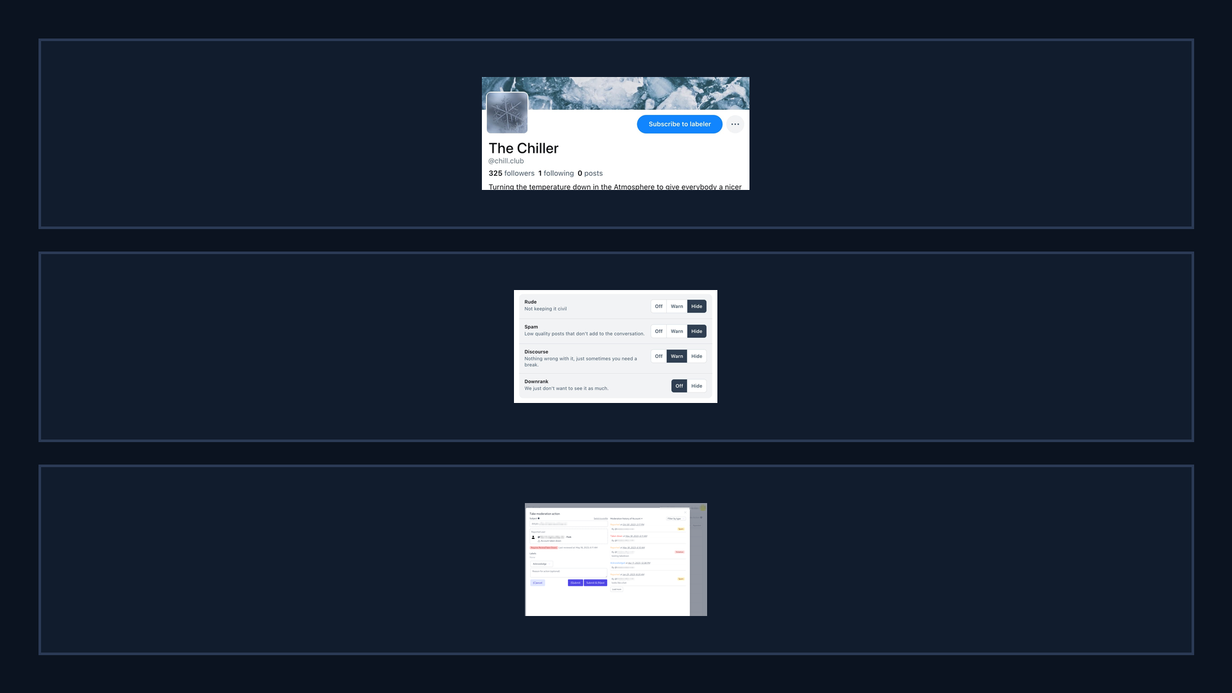
Bluesky UI: labelers + moderation tools
Takeaway: moderation is modular, users can subscribe to labelers and tune label handling.
A. Subscribe to labeler
A
Third-party policies
B. Per-label controls
B
Off / Warn / Hide
C. Ozone moderation UI
C
Operational tooling
Why it matters: power shifts

Slide 9
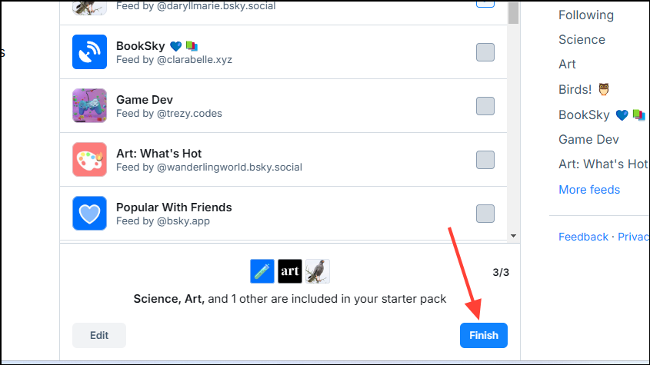
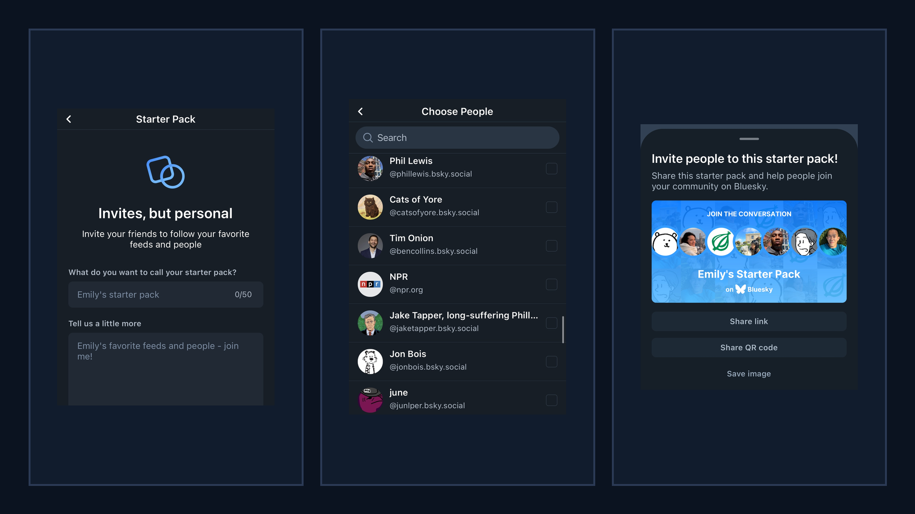
Bluesky UI: starter packs flow
Takeaway: starter packs bundle people (and context) into a single shareable onboarding object.
A. Create starter pack
A
B
C
Name + description
B. Choose people
Curation choices
C. Share pack
Link / QR / image
Why it matters: bundled exposure

Slide 10
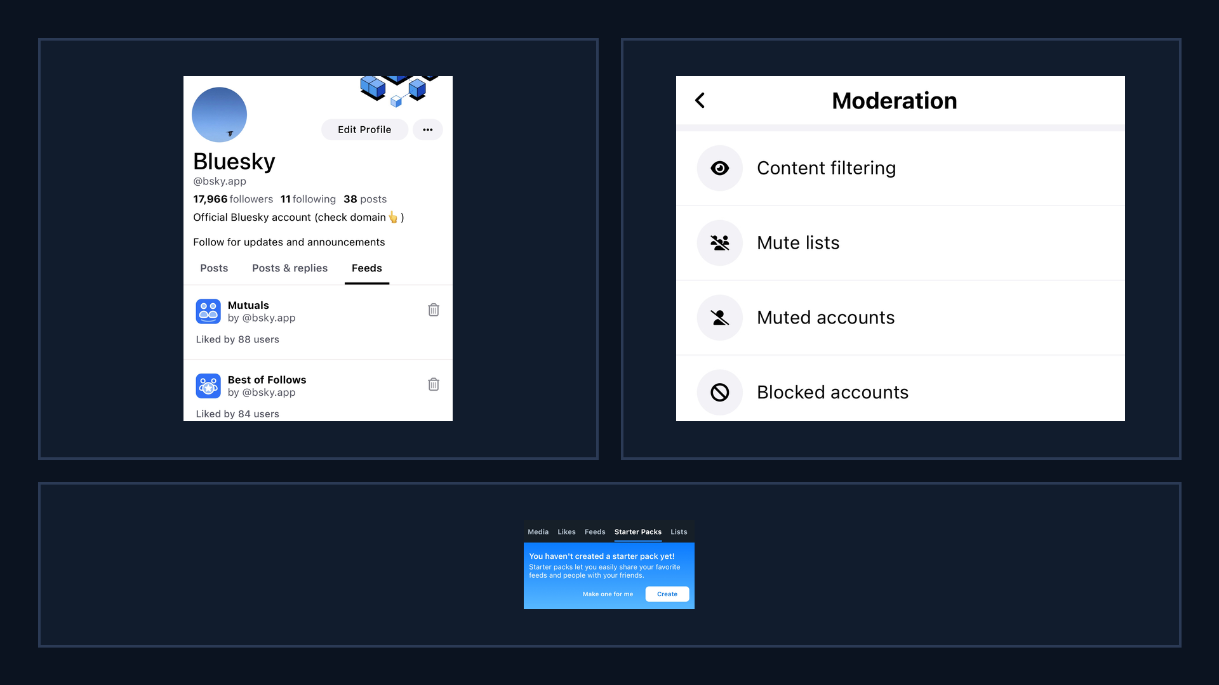
Bluesky UI: discovery surfaces
Takeaway: discovery is shaped by navigation, defaults, and safety settings surfaced in the UI.
A. Custom feeds tab
A
B
Algorithm marketplace
B. Moderation menu
Filtering settings
C. Starter packs tab
Onboarding surface
C
Why it matters: defaults steer

Slide 11
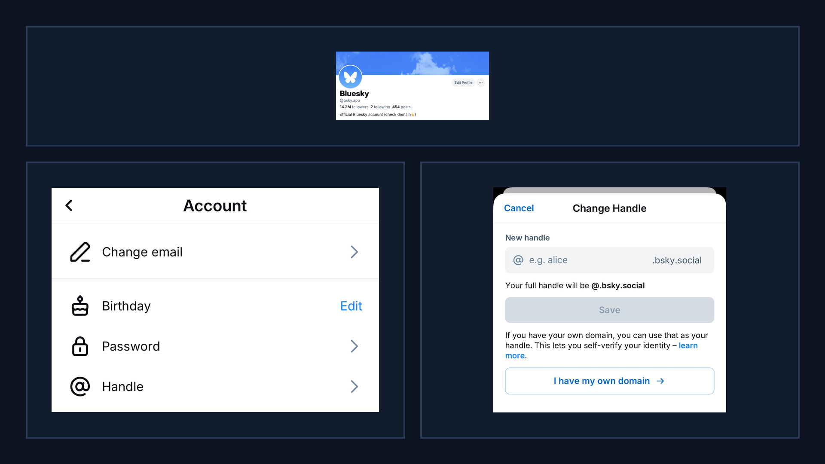
Bluesky UI: domain handles (surface → settings)
A. Domain handle profile
A
Trust signal
B. Settings: handle
B
C
Entry point
C. Use own domain
Verification flow
Why it matters: credibility

Slide 12
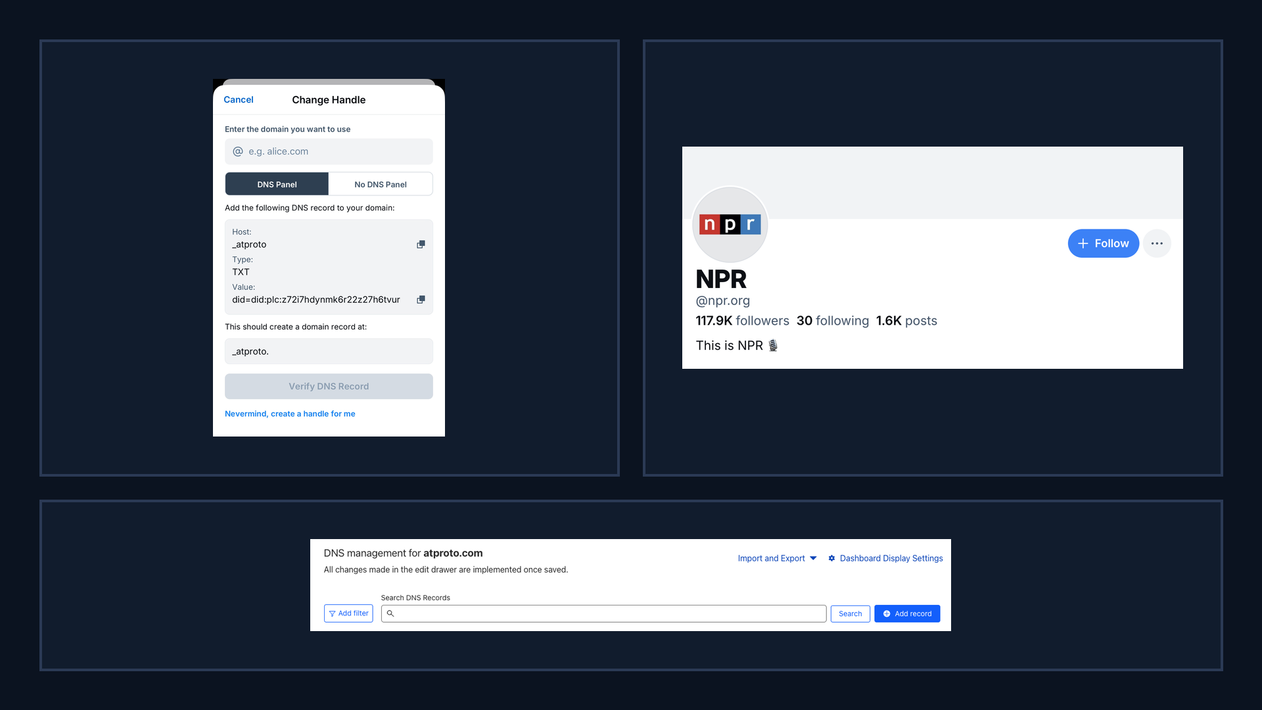
Bluesky UI: domain verification + examples
BLUESKY RQs + DATA
verification relies on external DNS tooling, creating measurable and potentially gameable steps.
A. DNS TXT record
A
B
Proof-of-control
B. Domain handle example
@npr.org
C. DNS management UI
External dependency
C
Why it matters: measurable steps

Slide 13
Research questions (R1-R5)
01
05
02
03
04
security and privacy scope.
R1 Discovery chokepoints? governance.
R5 Future experiment: gaming plus privacy attacks. extra guardrails.
R2 Provider buckets dominate? reliability.
R3 Same winners across feeds? manipulation.
R4 Labels vary by viewer? safety.

Slide 14
RQ1
In Bluesky, which is ‘pluggable,’ or decentralized. does onboarding/discovery behave like a centralized platform anyway? Concretely: how concentrated are starter packs and other discovery surfaces, and how much leverage do a few feed providers get over what new users see?
starterpacks.csv
starterpack_feeds.csv
discovery_feed_inclusions.csv
feed_generators_index.csv
popular_feeds.csv

Slide 15
RQ1: Exact Data We Will Use
Discovery concentration and provider leverage
Dataset | Minimum columns used | Purpose for RQ1
starterpacks.csv | starterpack_uri, creator_did, name | Identify who creates influential starter packs
starterpack_feeds.csv | starterpack_uri, feed_uri | Map packs to promoted feeds
discovery_feed_inclusions.csv | feed_uri, inclusion_count, inclusion_rank | Measure discovery concentration across feeds
feed_generators_index.csv | feed_uri, provider_bucket, service_did | Estimate provider-level leverage
popular_feeds.csv | feed_uri, popularity_rank | Compare discovery vs popularity baseline

Slide 16
RQ1: Conceptual Metrics (Minimal Inputs)
Keep only columns needed for brief professor-facing analysis plan
Dataset | Minimal fields kept | Metric we can compute
starterpacks.csv | starterpack_uri, creator_did | Creator concentration of starter packs
starterpack_feeds.csv | starterpack_uri, feed_uri | Pack-to-feed dependency network
discovery_feed_inclusions.csv | feed_uri, inclusion_count | Top-k share / concentration curve
feed_generators_index.csv | feed_uri, provider_bucket | Provider concentration (e.g., HHI/Gini)
popular_feeds.csv | feed_uri, popularity_rank | Rank-correlation with discovery exposure

Slide 17
RQ2
Across feeds that people commonly discover/use, does exposure concentrate among fewer creators, do the same creators win everywhere, and do large accounts get boosted more than in long-tail feeds?
feed_panel.csv
feed_items.csv
posts.csv
authors.csv

Slide 18
RQ2: Exact Data We Will Use
Exposure concentration, overlap of winners, and account-size effects
Dataset | Minimum columns used | Purpose for RQ2
feed_panel.csv | feed_uri, feed_group, selection_reason | Define comparison feed set
feed_items.csv.gz | feed_uri, rank, post_uri, author_did | Observed ranked exposure by feed
posts.csv.gz | post_uri, author_did, like_count, repost_count | Post-level engagement controls
authors.csv.gz | author_did, followers_count, posts_count | Account-size baseline (large vs long-tail)

Slide 19
RQ2: Conceptual Metrics (Minimal Inputs)
Four concise checks enough for a brief conceptual presentation
Dataset | Minimal fields kept | Metric we can compute
feed_items.csv.gz | feed_uri, author_did | Creator concentration by feed
feed_items.csv.gz | feed_uri, rank, author_did | Top-rank winner overlap across feeds
authors.csv.gz | author_did, followers_count | Size-decile boost comparison
feed_panel.csv | feed_uri, feed_group | Mainstream vs long-tail contrast

Slide 20
RQ3
What attacks are feasible when (a) feed generators are third-party services, and (b) they can be ‘growth-gaming’ by design? How do injected interactions (bots/sybils), collusion, and malicious ranking policies change exposure — and what defenses can labelers/users/platform enforce?
feed_generators_index.csv
feed_panel.csv
feed_items.csv.
posts.csv
post_labels.csv
feed_snapshot_status.csv
errors.csv

Slide 21
RQ3: Exact Data We Will Use
Attack feasibility, ranking manipulation, and enforceable defenses
Dataset | Minimum columns used | Purpose for RQ3
feed_generators_index.csv | feed_uri, provider_bucket, accepts_interaction, content_mode | Map attack surface by feed-generator design
feed_panel.csv | feed_uri, feed_group, selection_reason | Anchor attack scenarios to real feed groups
feed_items.csv.gz | feed_uri, rank, post_uri, reason_type | Detect rank shifts under injected interactions
posts.csv.gz | post_uri, author_did, external_domain, mention_count | Proxy for coordination/collusion patterns
post_labels.csv.gz | post_uri, label_src, label_val, label_neg | Check moderation coverage on attacked items
feed_snapshot_status.csv | feed_uri, success, http_status, error_type | Operational constraints for practical defenses

Slide 22
RQ3: Conceptual Metrics (Minimal Inputs)
Six compact analysis checks for brief discussion with professor
Dataset | Minimal fields kept | Metric we can compute
feed_items.csv.gz | feed_uri, rank, author_did | Baseline exposure distribution
feed_items.csv.gz | feed_uri, rank, reason_type | Injected-ranking pattern test
posts.csv.gz | post_uri, author_did, quote_count, reply_count | Collusion/coordination proxy
post_labels.csv.gz | post_uri, label_val, label_src | Defense signal coverage rate
feed_generators_index.csv | feed_uri, accepts_interaction | Susceptibility flag by feed
errors.csv | stage, error_type, http_status | Failure-aware defense feasibility

Slide 23
RQ4
How does ‘subscribe-to-labelers’ moderation behave in practice across feeds and communities? Where do labelers fail (coverage gaps, underrepresented groups, cross-community abuse), and how can labelers share models/signals without introducing privacy leakage or poisoning risks?
post_labels.csv
posts.csv (especially post_labels_json and author_labels_json)
feed_items.csv
feed_panel.csv

Slide 24
RQ4: Exact Data We Will Use
Labeler-based moderation coverage and cross-community behavior
Dataset | Minimum columns used | Purpose for RQ4
post_labels.csv.gz | post_uri, feed_uri, label_src, label_val, label_neg | Who labels what and with which polarity
posts.csv.gz | post_uri, author_did, post_labels_json, author_labels_json | Find coverage gaps on posts/authors
feed_items.csv.gz | feed_uri, viewer_mode, rank, post_uri | Check if labeled content still surfaces
feed_panel.csv | feed_uri, feed_group, provider_bucket | Compare moderation behavior across communities

Slide 25
RQ4: Conceptual Metrics (Minimal Inputs)
Four compact checks sufficient for current conceptual stage
Dataset | Minimal fields kept | Metric we can compute
post_labels.csv.gz | post_uri, label_src | Labeler coverage rate by source
posts.csv.gz | post_uri, langs_json | Language-based undercoverage checks
posts.csv.gz | author_did, author_labels_json | Author-level moderation consistency
feed_items.csv.gz | feed_uri, post_uri, rank | Exposure gap for labeled vs unlabeled items

Slide 26
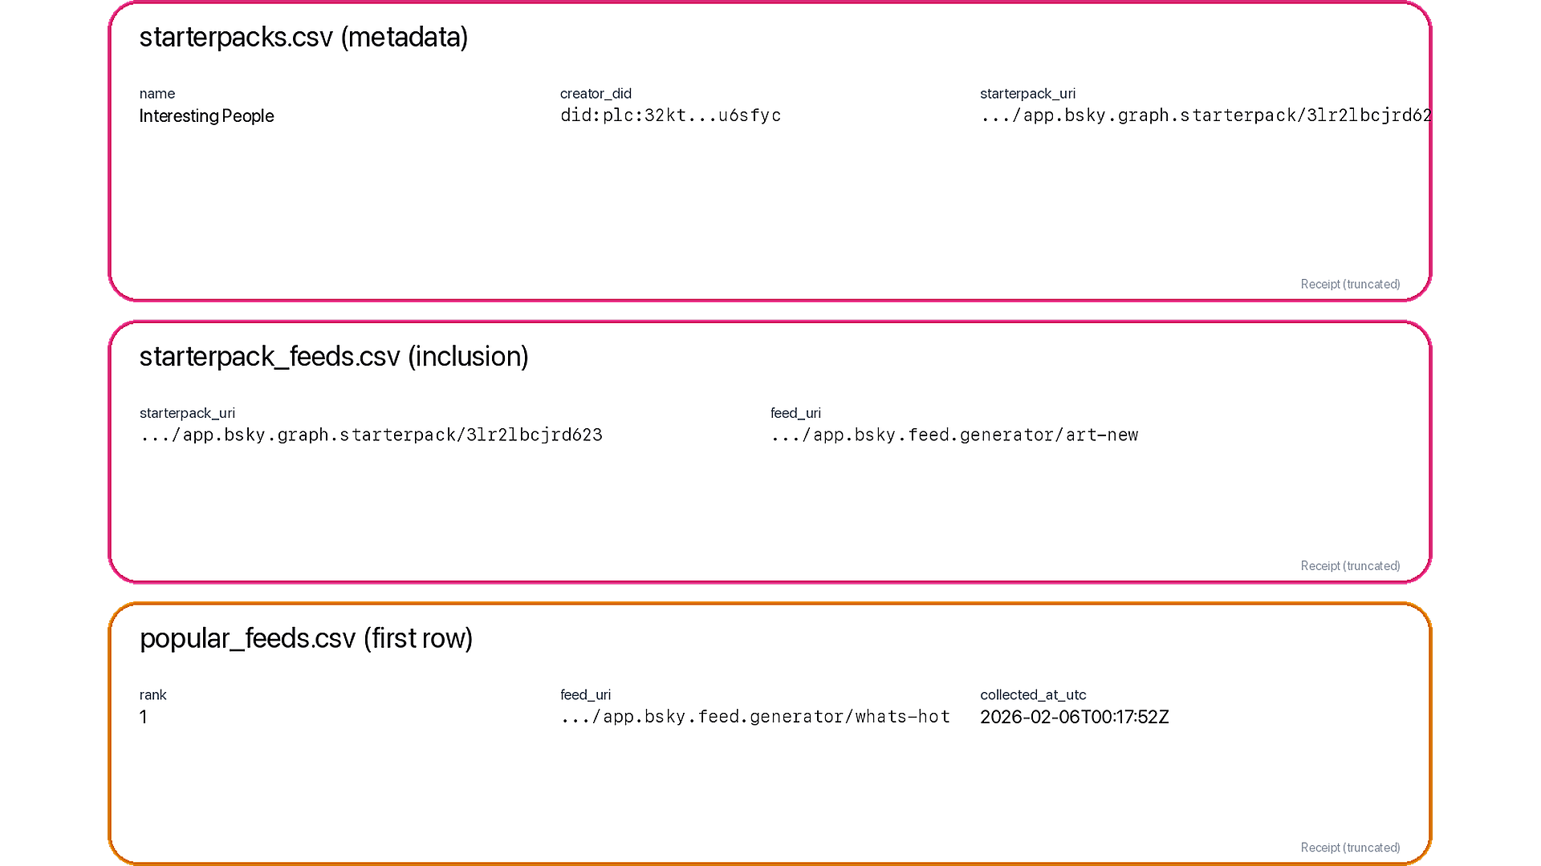
Data receipt: discovery surfaces (starter packs + popular list)
Takeaway: discovery is measurable via starter-pack inclusion and popular list ranks.
A. Starter packs
A
starterpacks + starterpack_feeds
B. Inclusion_count
B
slot_count (position-weighted)
C. Popularity_rank
Why it matters
C
Concentration + provider leverage
FEB 2026

Slide 27
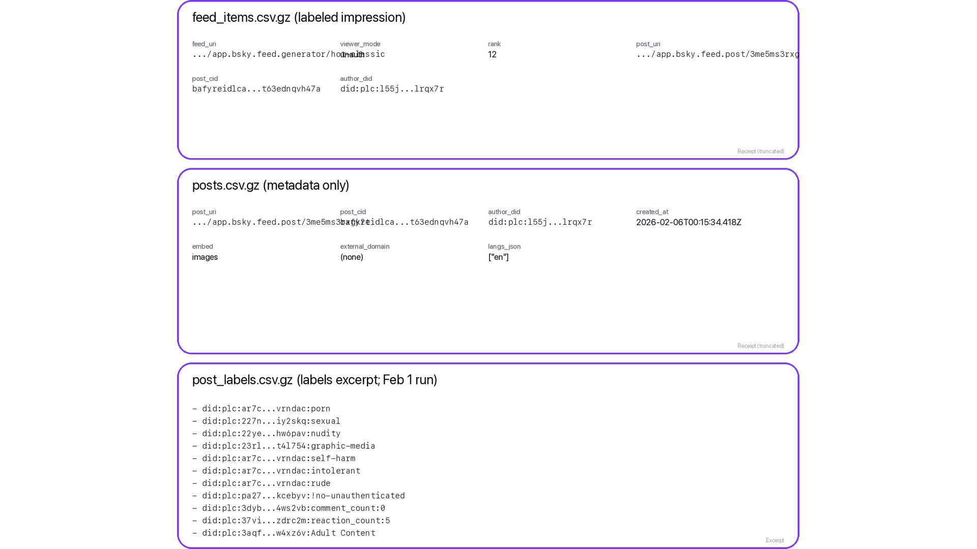
Data receipt: ranked exposure + risk labels
A. feed_items row
A
(feed_uri, viewer_mode, rank)
B. posts row
B
text + links + langs
C. post_labels row
C
H6: risk exposure
Feed auditing / mitigations

Slide 28
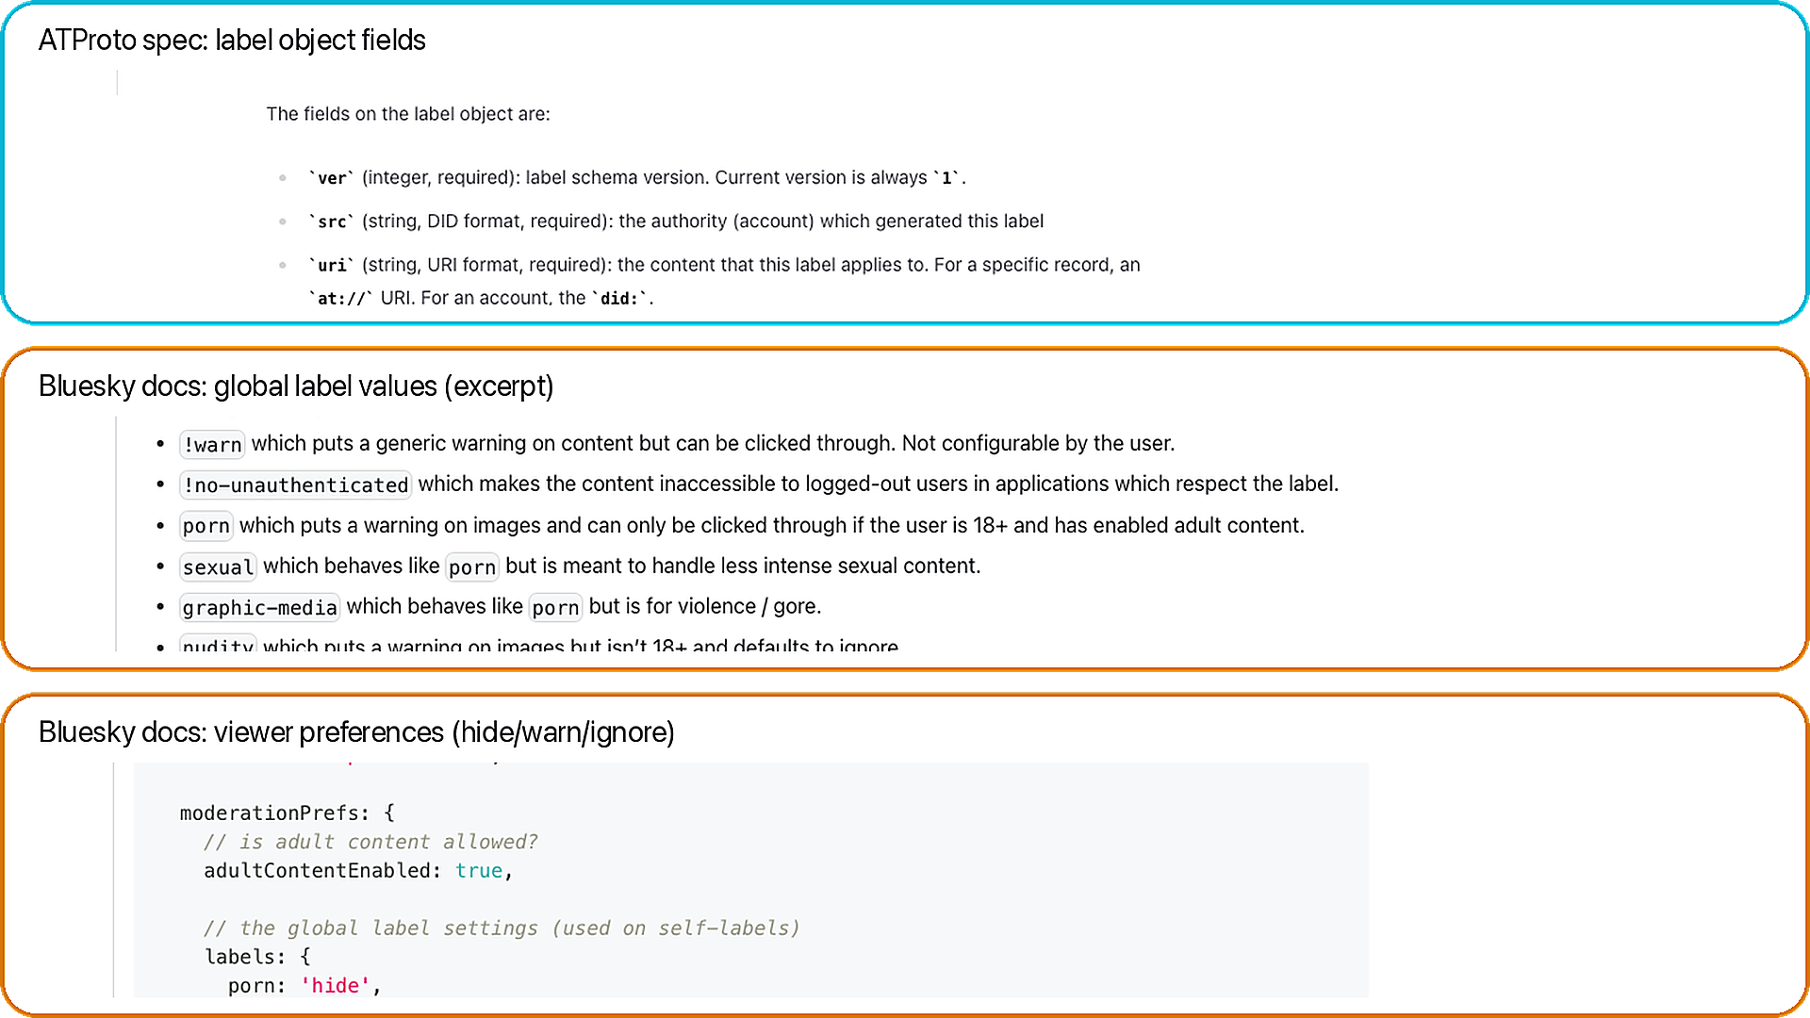
Data receipt: labels (schema + global values + prefs)
Takeaway: labels are structured safety signals; behavior depends on viewer prefs.
A. Label schema
A
(src, uri/cid, val, neg, cts)
B. Global values
B
protocol-defined strings
C. Viewer prefs
hide / warn / ignore
C
Docs grounding

Slide 29
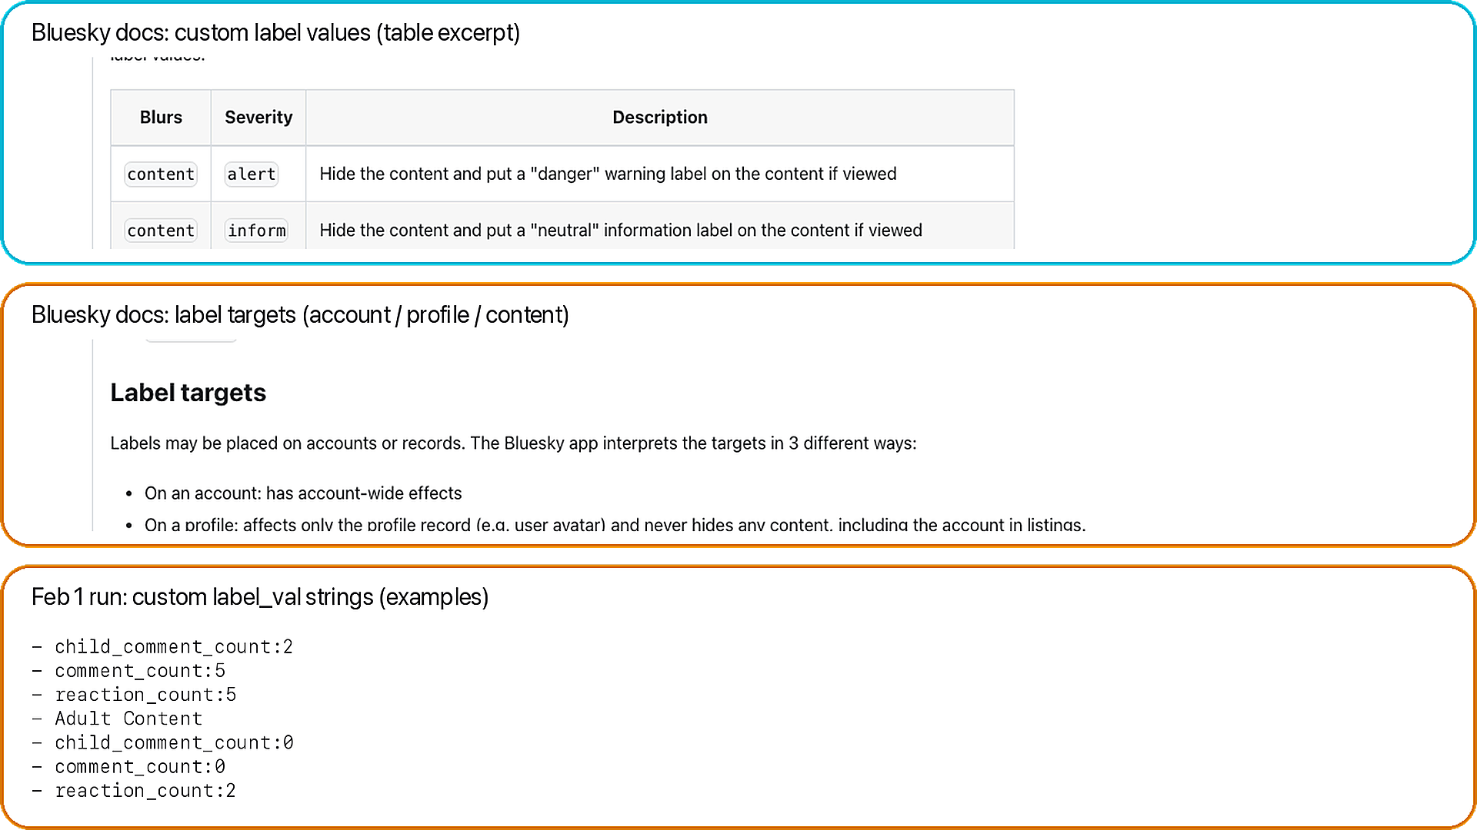
Data receipt: custom labels (definitions + targets)
Takeaway: labelers can define custom taxonomies; we preserve raw label_val strings.
A. Custom definitions
A
blur + severity + defaults
B. Label targets
B
account vs profile vs content
C. Observed values
dataset examples
C
Why it matters
FEB 2026

Slide 30
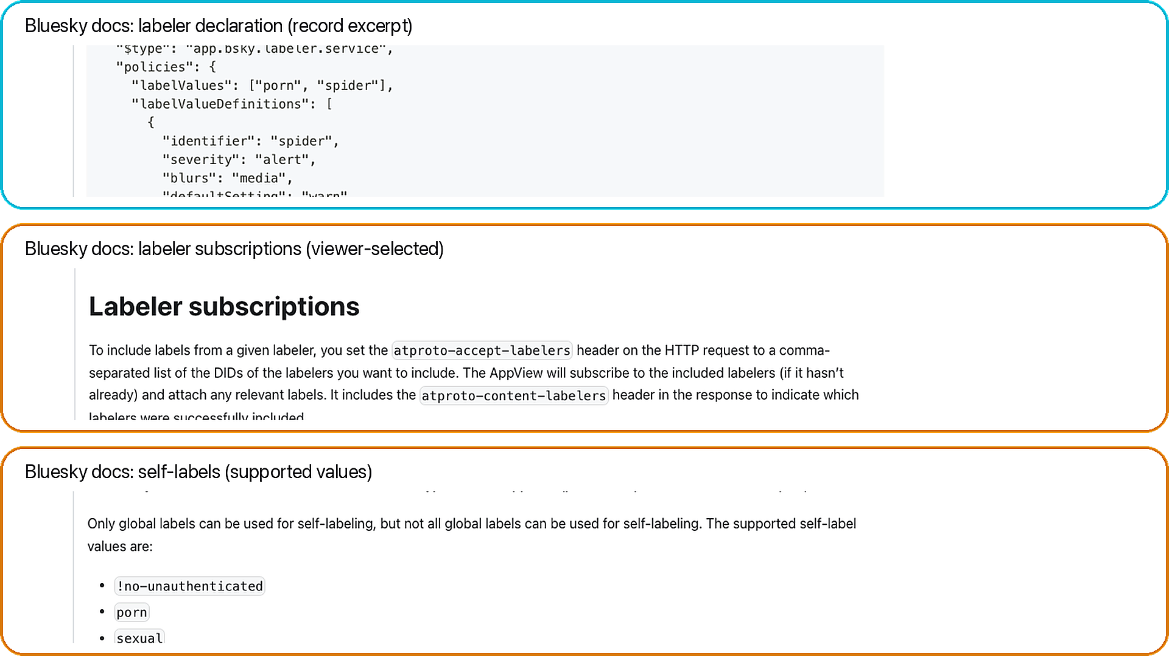
Data receipt: labelers (declarations + subscriptions + self-labels)
Takeaway: labels come from services; viewers choose which labelers to trust.
A. Declaration
A
values + policies
B. Subscriptions
B
viewer-selected
C. Self-labels
built-in values
C
Why it matters
FEB 2026

Slide 31
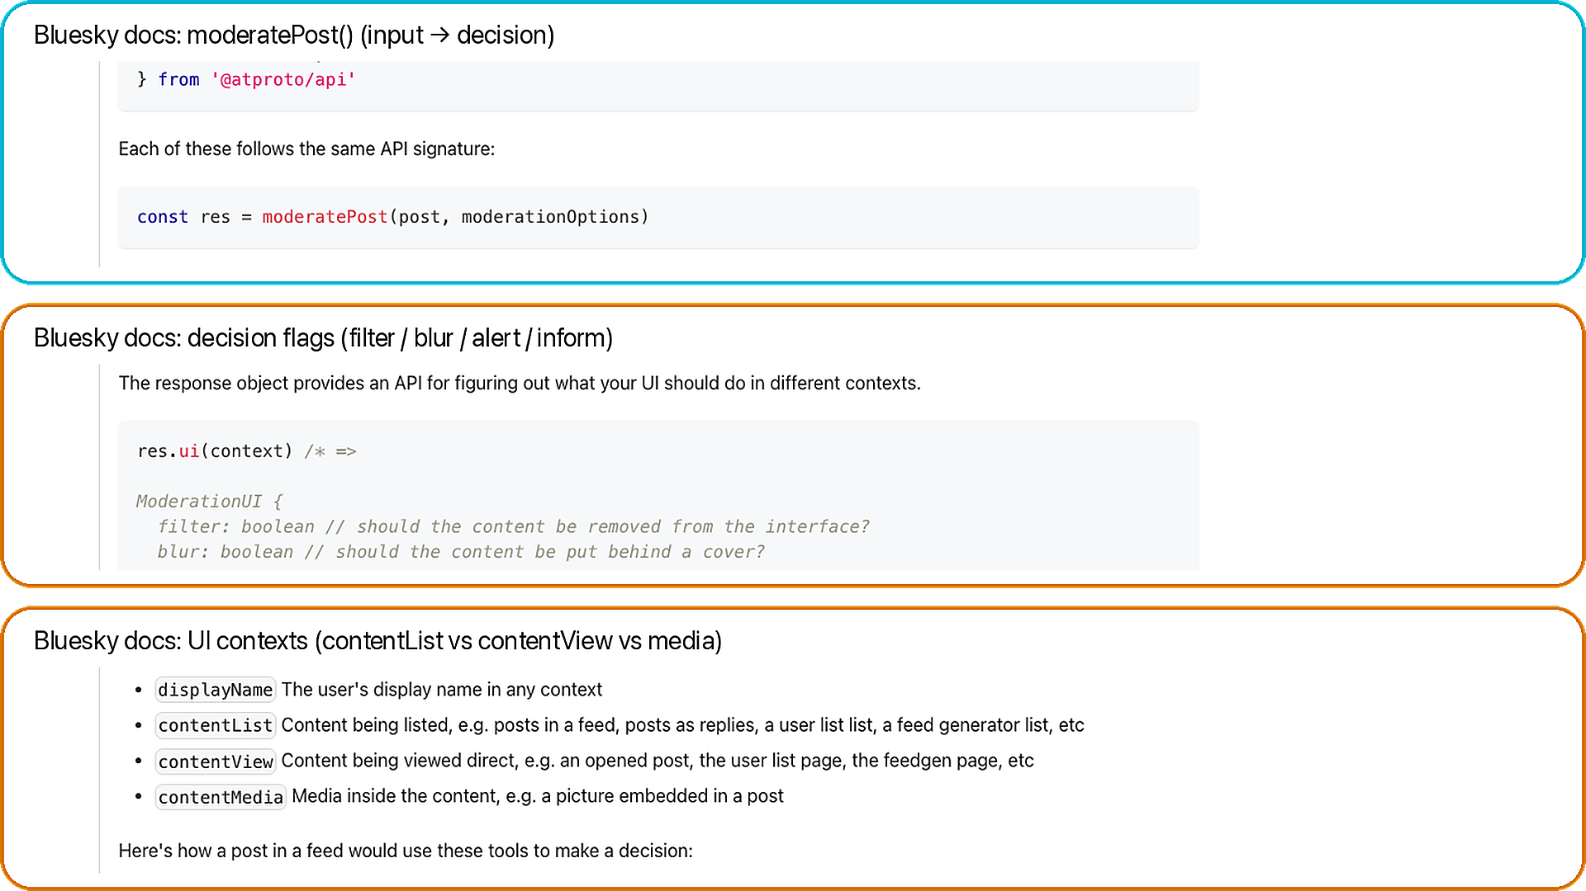
Data receipt: moderation decisions (flags + UI contexts)
Takeaway: the same label can blur/warn/filter depending on context + prefs.
A. moderatePost()
A
post + prefs → decision
B. Output flags
B
filter / blur / alert / inform
C. UI contexts
contentList vs view vs media
C
Docs grounding
FEB 2026

Slide 32
Collection credibility (one slide)
Read-only XRPC summary
• Relay + AppView reads.
• GET-only in this run.
• POST auth only if auth mode is used.
• No posting actions.
7-stage pipeline
• relay -> index -> packs -> popular -> enrich -> panel -> snapshot
• Reproducibility: state.db, manifest.csv, data_dictionary.csv, validation_report.csv.
FEB 2026

Slide 33
What this enables next + advisor asks
Ready measurements
• RQ1: measure discovery concentration.
• RQ2: map provider leverage.
• RQ3: test same winner overlap.
• RQ4: compare label variability.
What I need from you
• Ask 1: priority RQs and venue fit.
• Ask 2: recollect longitudinal, auth mode, or experiments?
FEB 2026

Slide 34
Appendix: official Bluesky UI screens
BLUESKY RQs + DATA
FEB 2026

